Slide 1
PITCH DECK answerforce trial program
Aashay Patel

Slide 2
Agenda
To analyse AnswerForce’s trial program.
Ways to improve the AnswerForce’s trial program.
Which customers are most likely to convert to as paid customers.

Slide 3
AnswerForce trial program
The AnswerForce is an AI product offered to Businesses to manage user queries on their websites.
On clicking the AnswerForce icon, users can get additional information
The program offered a 3-month long trial program for customers.
Businesses opt to enable chatbot services.

Slide 4
data used to study the program
Type of account
Chatbot use
Number of clicks
Chatbot service is offered as part of the trial program. Certain customers have used this feature.
Number of clicks on AnswerForce icon.
Customers are either Enterprises or Small businesses, based on employee count.

Slide 5
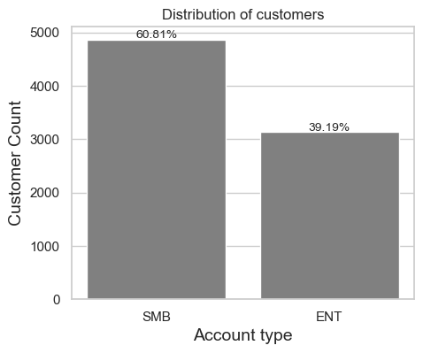
Distribution of customers
Total Customers : 8000
Small Businesses : 4865
Enterprises : 3135
The program is implemented in 2019 and 2020.

Slide 6
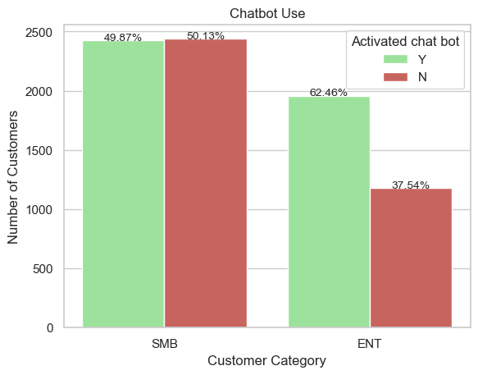
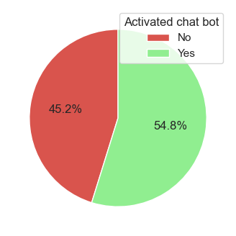
Chatbot Usage

Slide 7
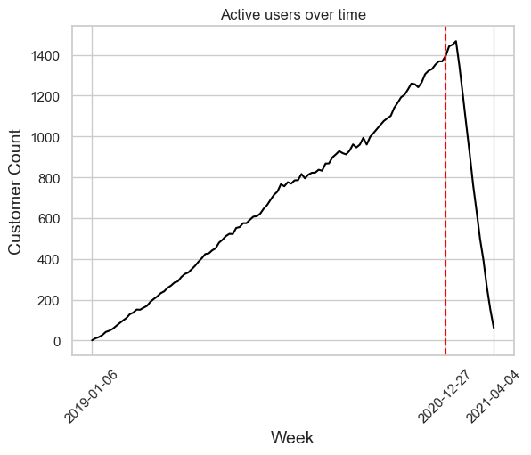
Active customers

Slide 8
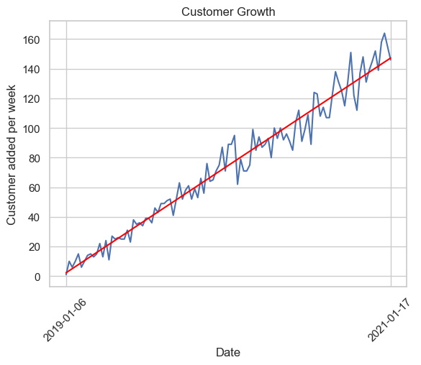
customers growth
The slope of the regression line = 1.32.
On average, 1.32 customers are added each week.
A positive linear growth in customers acquired.

Slide 9
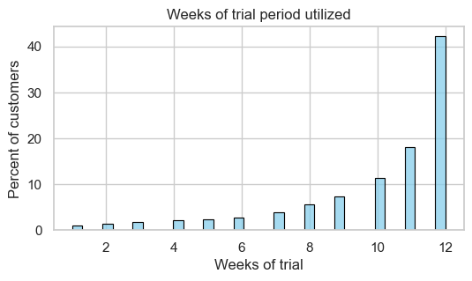
Usage of trial programs
42% customers utilized 12 weeks of trial.
30 % of users dropped from the trial period after week 10 and
week 11
6% of users dropped after completing 1 month of trial

Slide 10
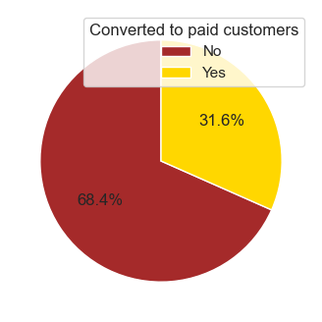
Customer conversion
2530 trial users converted to paid users.

Slide 11
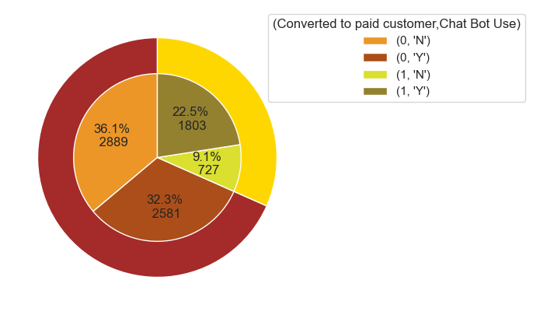
Chatbot use
Of the converted customers, 71% customers used chatbots.
52% of the customers who did not convert, used chatbot.

Slide 12
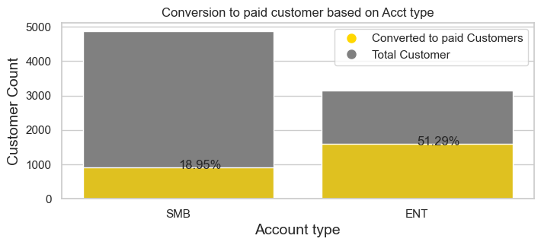
Conversion based on Customer type

Slide 13
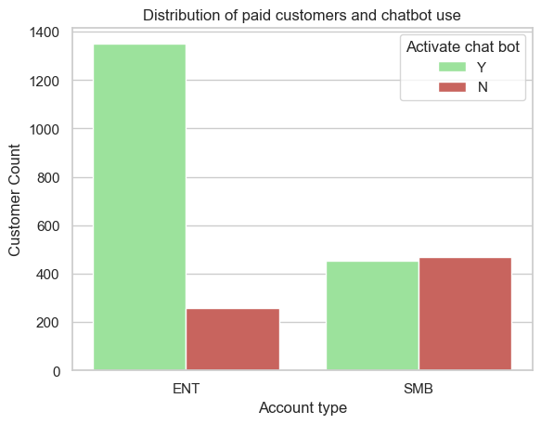
Converted customers and chatbot use
84% of converted Enterprise customers used chatbot service.
49% of converted Small business customers used chatbot service.

Slide 14
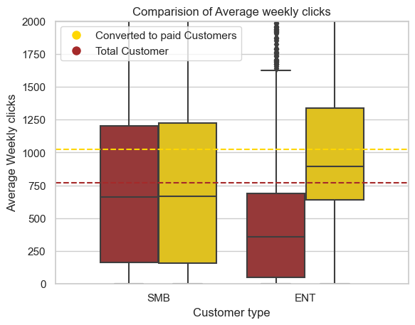
Average weekly clicks
Average weekly clicks of converted customers is 1025
Average weekly clicks of non converted customers is 768.
Significance of average clicks in case of Enterprise companies compared to Small businesses.

Slide 15
Possible Improvements in the trial program
Reaching out to small businesses and communicating about the chatbot.
Improving Chatbot capabilities, easier integration on customer platform.
Understanding the reasons why customers opt-out of the trial period.
Why small businesses conversion rates are low, compared to enterprise businesses?
Increase efforts to reach out to more enterprise businesses.
Understand why clicks are not an important conversion factor for small businesses.

Slide 16
Model building
Input parameters
Highlights of model
Avg Weekly clicks – Average weekly clicks of customers.
ENT – Account type (Categorical Variable )
1: Enterprise Business
0 : Small Businesses
CB_Y – Chatbot Use (Categorical Variable)
1: Customer uses chatbots
0 : Customer does not use chatbot
XGBoost classification model
To tackle imbalance in dataset, SMOTENN technique applies.
Resampling helped increase the recall factor of minority label.
Achieved accuracy of 0.73
Precision of 0.8 and 0.6

Slide 17
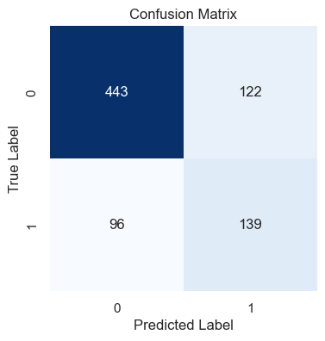
Metrics on test data
Label | Precision | Recall | F1-Score | Support
0 | 0.82 | 0.78 | 0.80 | 565
1 | 0.53 | 0.59 | 0.56 | 235
Training Samples | 3727
Test Samples | 800

Slide 18
SUMMARY
The trial program has been effective in converting 31.6% customers.
Enterprise businesses exhibited higher likelihood of conversion.
Chatbot feature has been instrumental in enhancing the probability of conversion.

Slide 19
THANK YOU
Aashay Patel

